Slide 1
Introduction to Digital Signature
Submitted by :
Sujash Naskar (Roll No.03)
Manu Gond (Roll No.08)
Anirban Saha(Roll No.15 )
Under guidance of :
Ms. Joyshree Nath

Slide 2
Contents
Introduction
Why we need Digital Signature
Contents of Digital Signature
Hashing
Encryption
Creation of Digital Signature
Verification of Digital Signature
A brief structure of creating and verifying the digital signature
Prerequisites to create Digital Signature
Advantages
Disadvantages
Applications
Conclusion
Reference

Slide 3
Introduction
A Digital Signature is a mathematical scheme for demonstrating the authenticity of a digital message or document.
It is the proof to the receiver that the message comes form the correct entity.
It can be used with any kind of message, whether it is encrypted or not(If privacy is not a major goal).

Slide 4
Why we need digital signature
Digital signatures provide:
Integrity
Authentication
Non-repudiation

Slide 5
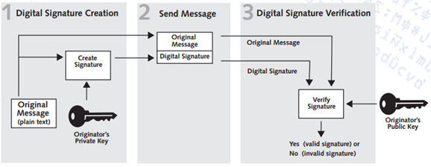
Contents of digital signature
A digital signature scheme typically consists of three algorithms:
A message digest generating hash algorithm.
A signing algorithm (based on encryption) that produces a signature from given message digest and private key of sender.
A signature verifying algorithm that given the message, public key and signature, either accepts or rejects message’s claim to authenticity.

Slide 6
Hashing
Hashing is the transformation of a string of characters into a usually shorter fixed-length value or key that represents the original string.
In digital signature creation we need a one-way hash function to create message digest.
To compute a message digest, the hash function used must be such a way that it will be computationally infeasible to find two messages that hash the same digest.
Examples of some cryptographic hash algorithms used in Digital Signatures are:
SHA-1 (160 bits)
SHA-256 (256 bits)
SHA-3 (512 bits)
MD2, MD4, MD5 (128 bits)

Slide 7
Encryption
Encryption is conversion of data into a form called a CIPHER TEXT.
The generated CIPHER TEXT can only be read if decrypted.
An encryption scheme uses a pseudo-random algorithm.
In theory it is possible to decrypt the message without possessing the key but considerable computational recourses and skills are required.
Keys:-
Public Key:- A public key may be placed in an open access directory for decryption of the digital signature of the sender.
Private Key:- private key is a variable that is used with an algorithm to encrypt or decrypt data.

Slide 8
CREATION OF DIGITAL SIGNATURE
A cryptographic hash algorithm is used to generate message digest of fixed length.
Generated result is then encrypted with sender’s private key.
Now the generated signature is attached with the message and sent.

Slide 9
Verification of digital signature
Verification of digital signature is done by reference of original message and given public key.
Verifying also relies on a formula which depends on:
The sequence of characters representing the original signed electronic data.
Public key of signing party.
The value representing the supposedly authentic digital signature.
The output of formula is a simple answer YES or NO.

Slide 10
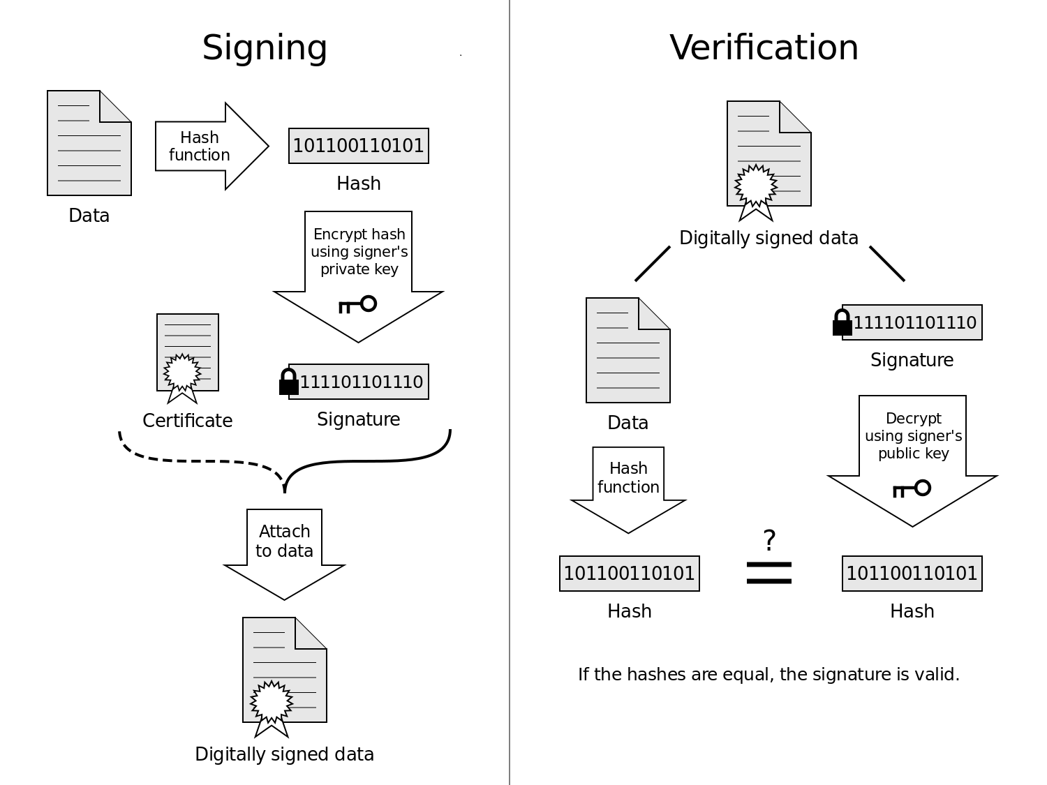
A brief structure of creating and verifying

Slide 11
Prerequisites to create a digital signature
Public-private digital key pair.
Certificate authority.
The public key certificate creates proof of the identity of the signer by using the services of a certificate authority.
A certificate authority uses a variety of processes to associate the particular public key with an individual.
The combination of public key and proof of identity result in a public key certificate (also called signer’s certificate).

Slide 12
Advantages
Authentication:
Identification of the person that sings.
Integrity of data:
Any change in data will be detected.
Non repudiation:
Author cannot be denied of his work.
Imposter prevention:
Elimination of possibility of committing fraud by an imposter.

Slide 13
disadvantages
Expiry: Digital signatures, like all technological products, are highly dependent on the technology it is based on. In this era of fast technological advancements, many of these tech products have a short shelf life.
Certificates: In order to effectively use digital signatures, both senders and recipients may have to buy digital certificates at a cost from trusted certification authorities.
Software: To work with digital certificates, senders and recipients have to buy verification software at a cost.
Law: In some states and countries, laws regarding cyber and technology-based issues are weak or even non-existent. Trading in such jurisdictions becomes very risky for those who use digitally signed electronic documents.
Compatibility: There are many different digital signature standards and most of them are incompatible with each other and this complicates the sharing of digitally signed documents.

Slide 14
applications
Electronic funds transfer
Software distribution
Smart Cards
Data storage
Blind Signatures
Time Stamped Signature

Slide 15
conclusion
Use of digital information is increasing dramatically, it becomes an integrated part of our daily life. So conserving the three property of data security becomes very important challenge. Currently digital signature is the only way to provide Integrity, Authentication and Non-repudiation to digital data. Though it has some certain disadvantages but it is being generously used as its advantages greatly overshadow its disadvantages.

Slide 16
REFERENCES
”Digital Signatures” by Jonathan Katz Springer, 2010 ISBN: 978-0-387-27711-0 Vincenzo Iovino University of Luxembourg
Foundations of Cryptography Basic Tools Oded Goldreich, Weizmann Institute of Science, Cambridge University Press, ISBN 0-511-04120-9 eBook
Goldreich, Oded (2004), Foundations of cryptography II: Basic Applications (1. publ. ed.), Cambridge [u.a.]: Cambridge Univ. Press, ISBN 978-0-521-83084-3
Dennis Campbell, editor, E-Commerce and the Law of Digital Signatures (Oceana Publications, 2005).
Cryptography and Network Security by Atul Kahate, ISBN-13: 978-0-07-064823-4, ISBN-10: 0-07-064823-9, Published by the Tata McGraw-Hill Publishing Company Limited.

Slide 17
Thank You

